Slide 1
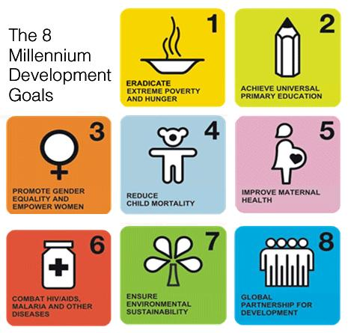
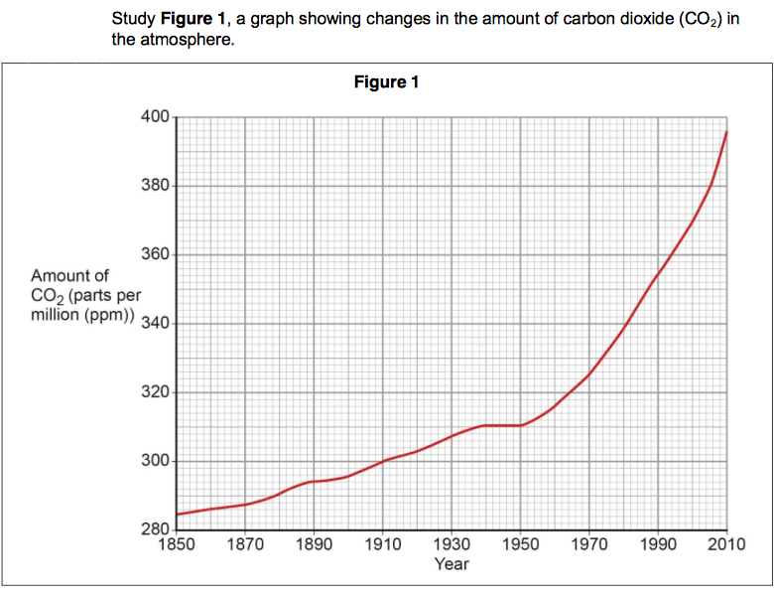
Command Word Writing Mat
----------------------------------------------------------------------------------------------------------------------------------------------------------------------------
The assess question
Example of an assess question
Use of place specific detail
The Millennium Development Goals (MDGs) were 15-year targets set by the United Nations (UN) in the year 2000. 189 countries signed the targets which aimed to improve the levels of development in poorer countries, including Zambia. Zambia’s progress towards meeting the MDGs by 2015 was mixed.
On the one hand, Zambia did not meet the target to halve extreme poverty (the number of people living on less than $1.25 a day). Urban areas, like Lusaka, saw much bigger reductions in poverty than rural areas. This means that Zambia remains one of the most unequal countries, with large differences between rural and urban areas. Consequently they have not successfully met this goal.
On the other hand targets such as improving access to primary schools were met by 2015. In 1990, just under 80% of children attended primary school and by 2015 this was approximately 90%. This means that children will receive a better education and consequently be more likely to secure better employment. Zambia has successfully met this goal. However, Zambia must improve access to secondary schools and higher education in the future.
An assess question assesses your understanding. You must weigh up both sides of something. You should also sub conclude linking back to the question. An assess question will be a longer marked question.
For an LIDC you have studied, assess how successful it has been in meeting two of the Millennium Development Goals (6)
Top tip 1: Weigh up both sides and use connectives to show that you are doing this.
The point made is developed and linked to the case study.
A connective is used in both paragraphs to show balance.
Top tip 2: Use place specific and case study detail
Top tip 3: Fully explain your points using CATT and always link back to the title. Use words from the question to help you do this.
-----------------------------------------------------------------------------------------------------------------------------------------------------------------------------
The describe question
Example of a describe question
When answering a describe question, use TEA.
What is the trend? Does it go up or down? fluctuate? stay the same?
What data can you extract? To include the data, make sure that you use accurate numbers and the unit of measurement
What anomalies can you notice? What does not fit the pattern? What is unusual?
Describe the changes in the amount of carbon dioxide in the atmosphere (3 marks)
As seen in figure 1, the amount of carbon from 1850 to 2010 has increased. In 1850 there was 284 ppm compared to 396 ppm, an increase of approximately 112 ppm. However, just after 1950 there was a slight decrease in carbon dioxide in the atmosphere to 310 ppm.
Top tip 1: In a describe question where you are given a map, include compass points
Top tip 2: When describing distribution, is the spread of something even or uneven?
Top tip 3: Ensure that your data is clear and accurate. Use the unit of measurement in your response.

Slide 2
-----------------------------------------------------------------------------------------------------------------------------------------------------------------------------
The explain question
Example of an explain question
Example of an explain question
For a country you have studied, explain how food security is achieved by one method at a local scale (6)
An explain question means that you have to develop your points. You have been taught to develop your points by using CATT (Consequently, As a result, This means that and Therefore). In an explain question, half the points available and this tells you how many separate points you need to make e.g. Explain the social impacts of climate change upon the UK (4) would require you to make 2 points, with 2 clear developments.
Explain the social impacts of climate change upon the UK (4)
Tanzania is an LIDC located on the east coast of Africa. To be food secure a person has physical and economic access to food that meets dietary needs and food preferences. Tanzania is ranked 96th out of 113 countries in the Global Food Security Index with a score of 47.6 out of 100.
Babati is an area in northern Tanzania. Between 1999 and 2006 a UK based charity ran a bottom up programme called goat aid, with the aim of improvement nutrition and income. Food security was achieved as the goats manure helps to make the land more fertile. As a result more crops are grown and consequently food security is achieved.
However, the vet bills are expensive if the goat becomes unwell and goats also need a lot of water. This means that there is less water for people to cook with, therefore reducing food security.
Use of place specific detail
Climate change may lead to flooding. This means that people may experience their homes flooding, leading to higher insurance premiums. In addition, climate change may also mean that Scottish ski resorts could close due to lack of snow. As a result people will lose their jobs which will mean they have less money for essentials.
Top tip 1: Always use CATT. If you do not, you will not achieve high marks.
The point made is developed and linked to the case study
Top tip 2: In a longer question (4, 6 etc.) use specific examples.
Top tip 3: In a 6 mark response, know your case studies. Include key words from the title and clearly develop using CATT. Ensure that you link back to the question.
The point made is developed and linked to the case study
-----------------------------------------------------------------------------------------------------------------------------------------------------------------------------
The evaluate question
Key word defined
Climate change is the long-term change in global or regional climate due largely to increased levels of CO2 in the atmosphere. Globally the climate is warming, there is a variety of evidence to show that this is the case. Since 1914 the Met Office has recorded reliable climate change data. This means that from using weather stations, satellites, weather balloons, radar and ocean buoys they can see that there has been an average rise in sea levels of 20cm since the 1900s. Consequently many people believe that the evidence does suggest the climate is changing, but it must be noted that technological recording is better today.
Diaries and written observations can suggest evidence of climate change at the time, such as the price increases in grain in Europe and people emigrating due to crop failures. In addition, cave paintings of animals in France and Spain between 11,000 and 40,000 years ago show significant climate change. This means that we can see that the climate is different from today and changing. However, it is difficult to date cave paintings, meaning that they are not accurate and the evidence is not reliable to suggest that the climate is changing.
Furthermore, sea ice positions show that many of the world’s glaciers are retreating as temperatures rise and ice melts. Arctic sea ice has declined in volume by 10 per cent in the last 30 years. Data recording is considering very reliable, meaning that we can see the climate is changing. However, it does not date back very far, consequently some people believe that it is not reliable to suggest that the climate is changing.
Example of an evaluate question
Evaluate means ‘judge’ on its strengths and weaknesses’. You must include data and clearly explain your points. It also requires a mini conclusion and sub conclusions by linking back to the question.
An evaluate question is typically marked out of 8, therefore SPaG marks are available, so ensure that your written work is clear, that you have used punctuation, a structure and key words.
Evaluate the evidence that suggests that global climate is currently changing (8 marks*)
Explained points and judgement of evidence. There is also a use of data.
Top tip 1: Always use CATT. If you do not, you will not achieve high marks.
Top tip 2: Ensure that you look at both sides (for/against, positive/negative, success/failure, effective/not effective) and link back to the question.
Top tip 3: Include data and specific information

Slide 3
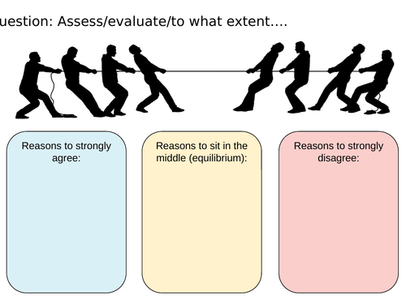
-----------------------------------------------------------------------------------------------------------------------------------------------------------------------------
The state question
Example of a state question
A state question means that you make a brief point. You do not need to develop your response as these are low scoring questions, usually just a couple of marks.
State two causes of suburbanisation in ACs (2)
Cheaper housing
Less pollution
-----------------------------------------------------------------------------------------------------------------------------------------------------------------------------
The suggest question
Example of a suggest question
Bottom up approaches are community based, led by NGOs (non-governmental organisations). They are also usually cheaper than top down approaches.
Suggest means explaining how or why something might occur. These can be smaller marked questions or larger marked questions.
Suggest two features of a bottom up approach (2)
-----------------------------------------------------------------------------------------------------------------------------------------------------------------------------
The to what extent question
Example of a to what extent question
An ageing population is the number of people in the UK born over the age of 65. People in the UK are living longer due to better healthcare and the average life expectancy in the UK is 79 for a male and 83 for a female. There are over 3 million people aged over 80 in the UK and to some extent an ageing population is positive.
On the one hand, an ageing population is positive as they help with childcare. This is positive as the economically active are able to work. As a result this helps the economy. To some extent an ageing population is positive.
On the other hand, an ageing population is negative as they have greater medical needs and the costs of looking after them will rise in the future. This means that they will need an increasing amount of care to enable them to stay in their homes. As a result, their children may not be able to work any longer, as they may be responsible for their care. To some extent an ageing population is negative.
Overall, to some extent an ageing population is positive as they also bring negatives which must be considered.
A to what extent question or how far do you agree question, means that you must show how far you agree or disagree with a statement (‘to a certain extent’, ‘to a great extent’ or ‘to a very small extent’). These are longer marked questions often with SPaG marks (but not always). Ensure you develop your points using CATT and include case study detail.
Key word defined and background information
To what extent is an ageing population positive in the UK (6)
Use of connective to look at one side of the argument. The point is clearly made and developed.
Top tip 1: Weigh up both sides and use connectives to show that you are doing this.
Top tip 2: Make sure you clearly state in the introduction and within your conclusion to what extent you agree.
Use of connective to look at the other side of the argument. The point is clearly made and developed.
Top tip 3: Fully explain your points using CATT and always link back to the title. Use words from the question to help you do this.
Conclusion linking back to what extent.
-----------------------------------------------------------------------------------------------------------------------------------------------------------------------------

Slide 4
Some helpful structure strips
Assess Make an informed judgement | Evaluate Judge from available evidence | To what extent Judge the importance or success of (strategy, scheme, or project)
Introduction Introduce the topic content from the question and provide a background Define any words | Introduction Introduce the topic content from the question and provide a background Define any words | Introduction Introduce the topic content from the question and provide a background Define any words Say to what extent you agree
Paragraph 1 Make your initial argument and judgement by making a point Support your point with evidence Explain your point using CATT Ensure you have made reference to the relevant case study Link back to the title (use the key words from the title) | Paragraph 1 Start by using connective to show balance (on the one hand) Make a point, support it with evidence and explain (CATT) the evidence linking back to the question | Paragraph 1 Make an initial judgement to the extent of the importance or success Make a point, support it with evidence and explain (using CATT) the evidence linking back to the question. Make reference to relevant case studies or evidence Link back the question/to what extent
Paragraph 2 Make a counterargument Support your counterpoint with evidence Explain using CATT Ensure you have made reference to the relevant case study Link back to the title (use the key words from the title) | Paragraph 2 Make an alternative point by using on the other hand Support your point with evidence and explain (using CATT) the evidence linking back to the question | Paragraph 2 Make a counterpoint or another supporting point Make a point support with evidence, explain the evidence Make reference to relevant case studies or evidence Link back the question/to what extent
Conclusion State your overall judgement using the evidence previously stated | Conclusion State your overall judgement using the evidence previously stated | Conclusion State your overall judgement using the evidence previously stated
How important? | How significant? | How far do you agree? | How successful?
Extremely | Extremely | Completely | Extremely
Very | Very | Strongly | Very
Quite/Moderate | Quite/Moderate | Undecided | Quite
Somewhat/Slightly | Somewhat/Slightly | Slightly | Slightly/little
Minor or little | Insignificant | Disagree | Unsuccessful
Always demonstrate your subject knowledge. Explain the relevance of the evidence you provide.
Use geographical terms where possible.
Use facts and specifics from case studies where possible.
Always link back to the title.

