Slide 1
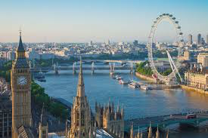
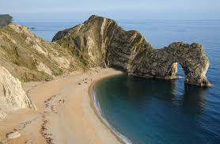
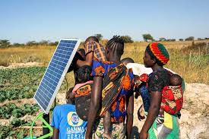
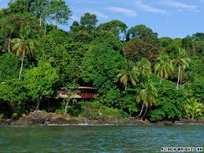
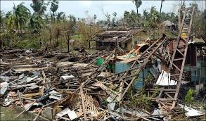
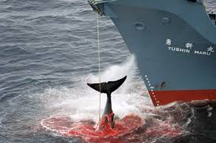
Case study revision guide
Name:
Class:
Exam 1 | Exam 2 | Exam 3
Natural World | People and Society | Geographical exploration
70 marks | 70 marks | 60 marks
1 hour 15 minutes | 1 hour 15 minutes | 1 hour 30 minutes
35% | 35% | 30%
17 May 2024 PM | 05 June 2024 AM | 14 June 2024 AM

Slide 2
Contents page:
Exam number: | Theme: | Case study: | Page number:
1 | Natural weather hazard - UK | Cumbria flooding - 2016 | 4
1 | Natural weather hazard – non UK | California Drought – 2010 2013 | 5
1 | Tectonic hazard | Turkey/Syria Earthquake 2023 | 6
1 | Impacts of Climate Change - Local | UK | 8
1 | Impacts of Climate Change – Global | Tuvalu | 9
1 | UK river landscape | River Tees | 11 - 12
1 | UK coastal landscape | Jurassic Coastline | 13 - 14
1 | Managing the tropical rainforest | Croker Range, Borneo | 16 - 17
1 | Local example of sustainable management of the Arctic | Whaling in the Arctic Ocean | 18
1 | Worldwide example of sustainable management of the Antarctic | The Antarctic Treaty | 19
2 | AC city | Leeds | 21-22
2 | LIDC/EDC city | Bangalore | 23-24
2 | The development of an LIDC | Zambia | 26-27
2 | Changes in an economic hub | Oxford | 29
2 | UK’s role in a Global conflict | Somalia | 30
2 | Population change in UK region | London | 31
2 | Food security in one country | Tanzania | 33-34

Slide 3
Topic 1 – Global Hazards
Weather Hazards:
Case studies of two contrasting natural weather hazard events arising from extreme weather conditions. The case studies must include a natural weather hazard from each bullet point below:
flash flooding or tropical storms
heat wave or drought.
There must be one UK based and one non-UK based natural weather hazard event.
For each chosen hazard event, study the place specific causes (including the extreme weather conditions which led to the event), consequences of and responses to the hazard.
Tectonic Hazards:
A case study of a tectonic event that has been hazardous for people, including specific causes, consequences of and responses to the event.

Slide 4
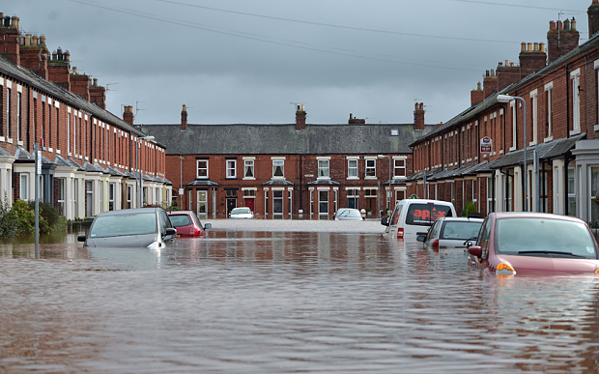
Cumbria Flooding - 2015
Location
Cumbria is located in the North West of England, just south of the border with Scotland.
Towns and villages which were affected by Storm Desmond flooding included Keswick, Appleby and Carlisle.
Causes
As a result of Storm Desmond the area received up to 341 mm of rainfall in 24 hours on 5th / 6th December. This was a new British record. In the weeks leading up to Storm Desmond, there had been low pressure weather systems passing over the area. Low pressure brings rain, so the ground was already saturated. Ground which is saturated becomes impermeable, and cannot absorb any more water.
The Lake District has a lot of V-Shaped valleys with steep sides meaning the water runs straight into the river.
As the area is mostly moor, there are few trees to intercept the rain.
The geology is mostly slate, limestone and granite. These rocks are impermeable, which means water cannot infiltrate (permeate) into the ground.
There are many small towns and large villages in The Lake District. When land is urbanised the ground becomes impermeable which means it then acts like impermeable rock, and cannot absorb rainfall, which leads to more surface run-off and flooding.
Consequences
Up to 1,000 people in Cumbria were evacuated from their homes
Estimated £500m worth of damage to people’s homes and property
Low-lying farmland and livestock (animals) swamped by flood water
Small business had to close and some were shut for many months
40 schools and other services were closed
Roads and bridges were damaged which meant people had to travel long distances to cross rivers
Responses
More than 100 flood warnings, and 70 flood alerts in place in northern England (issued by the Environment Agency). This allowed people to prepared defences, or evacuate, before the flood water allowed.
After the Cumbria flooding the Government helped insurers to introduce new insurance, called FloodRe, which helps people in areas at risk of flooding to be able to afford home insurance.
To help homeowners whose properties were affected by flooding, the government gave grants of up to £5,000

Slide 5
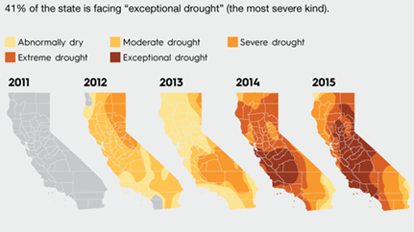
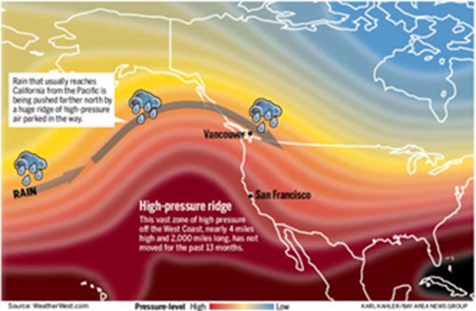
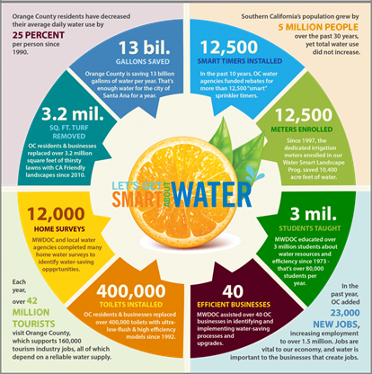
Drought in California, 2013
What is a drought? A drought is a period of below average precipitation in an area, resulting in prolonged shortages in its water supply
Location: West coast of USA, bordering the Pacific Ocean.
Colorado River runs through California- being used up very quickly meaning demand exceeds (is greater than) supply.
Why was there a drought in 2013?
Driest period in California in 500 years
Average rainfall in 2013 was 4 inches
Roughly half of the water in California is used for lawns
Three of the largest cities in the US are in California- Los Angeles, San Diego and San Jose
Huge agricultural industry in the state
An area of high pressure, 4 miles high, pushed rain away from the area
Impacts of the drought:
Short Term
Surface water decreased meaning:
Less water available for agriculture and the cities
Hydroelectric power is less effective
Negative impact on navigation and recreation
Habitats and aquatic species affected
Long Term
Larger and more frequent fires, especially in areas used for recreation
Excessive pumping of water from ground water supplies and removal of water from aquifers leads to land sinking, permanent loss of water from the aquifer system
Excessive removal of water from the aquifer causes sea water to enter the aquifer affecting the quality of the water (makes it salty)
Social Impacts:
10,000 people have lost their jobs within agriculture as there is not enough land to farm from.
People have to spend more on food as the food imported is more expensive
There is a greater demand than supply for food produced in California
Farmers are losing their livelihoods as they cannot grow crops with such a lack of water
Farmers are collectively spending $580 million on extracting water from the ground
Environmental Impacts:
42% of irrigated farmland had its water supply cut by up to 80%
California’s forests are more susceptible for larger and more frequent fires.
The state is forced to use more fossil fuels to make up for the lack of hydro-electric power.
Ground water can no longer fill underground water wells.
A lack of surface water affects nearly everything from hydroelectric power to recreation, and there is a shortage of this
Solutions
25% reduction in water usage ordered by the state government.
50% of Orange County’s water supply is imported from other areas.
$12 billion investments from Southern California water providers over the last 20 years.
Mandatory restrictions on water usage in certain areas.
Schools have been given the relevant information to inform students on how to conserve water most efficiently
12,500 water metres installed in homes
400,000 water saving toilets installed
3.2 million square feet of turf removed.
13 billion gallons of water saved

Slide 6
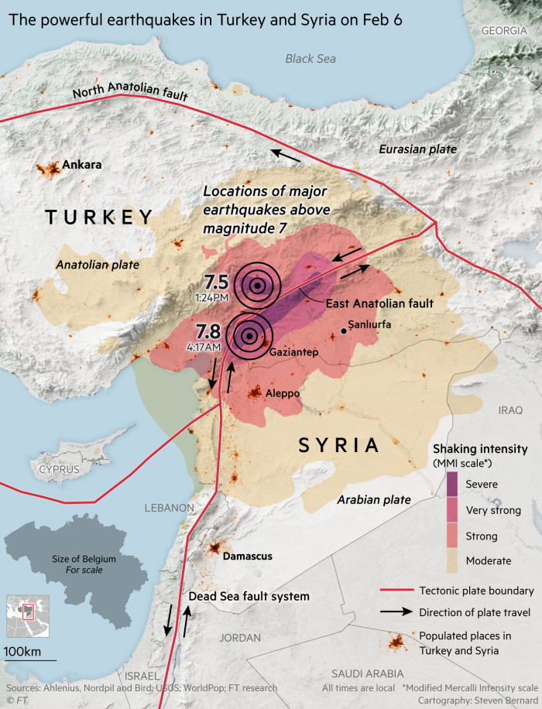
Turkey-Syria Earthquake 2023
On 6th Feb 2023, an earthquake with a magnitude of 7.8 struck Turkey and Syria at 4.17am. This was followed 10 hours later by a second magnitude 7.5
Location
The quake struck on the East Anatolian fault close to the boarder between Turkey and Syria. The epicentre was 34km west of the city of Gaziantep in southern Turkey. The focus of the earthquake was shallow at a depth of only 18km.
The Arabian plate is moving north towards the Eurasian plate squeezing the Anatolian plate to the west. This has created a conservative plate boundary where friction where plates get stuck and pressure builds before giving way and causing the earthquake.
Primary Impacts
Over 56,000 people died
100,000 people injured
At least 4 million buildings in Turkey damaged
Cracks in the roads stopping aid getting through
Historical sites in Syria destroyed
A gas pipeline in Hatay exploded
Gaziantep castle and several mosques destroyed
Hospitals in Hatay (Turkey) destroyed
Runway for Hatay airport was split and uplifted
At least 453 schools in Syria damaged
Secondary Impacts
2.7 million people homeless in Turkey
5.37 million people homeless in Syria
Hypothermia became a major risk factor for people due to the snow and freezing winter temperatures
Children were separated from their families and are vulnerable
Trauma and mental health issues
Over $100 billion damage in Turkey
Over $5.1 billion damage in Syria
The Afrin dam in Syria was damaged and burst 3 days later flooding the village of Al-Tloul and displacing 500 families
Reasons why the impact was so great
Civil war in Syria for the previous 12 years means the population was already poor and needing humanitarian assistance
Many Syrians in the north of the country were living in poorly built homes that were not built to withstand earthquakes
In Turkey many newly built buildings collapsed despite new building codes being introduced in 2018
Long-term Responses
210 million tonnes of rubble removed within Turkey
500,000 new houses need to be built. The president has committed to rebuilding every building within a year, this is a really bold promise and building work has slowed since he wont the election. Syria will take far longer to rebuild due to the lack of heavy machinery.
There has been criticism of the wide disparity in response between Syria and Turkey. A major challenge to Syria’s response is the instability of the region and the closed border with Turkey.
The World Bank has made $1.78 billion available for the reconstruction of Turkey and Syria.
Immediate Responses
Immediate help was given with search and rescue teams using dogs and machinery to find people in collapsed buildings
60,000 officials were deployed by the government to support the search effort
Turkish airlines provided free flights to 11,780 people who lived across Turkey who were volunteering in the search
The EU sent rescue and medical teams along with €3million aid to Turkey and €3.5million to Syria
NATO provided 1000 containers to be used for temporary housing

Slide 7
Topic 2 – CHANGING CLIMATE
Global Impacts:
Explore a range of social, economic and environmental impacts of climate change worldwide such as those resulting from sea level rise and extreme weather events. The impacts studied should relate to the 21st century.
UK Impacts:
Explore a range of social, economic and environmental impacts of climate change within the UK such as the impact on weather patterns, seasonal changes and changes in industry. The impacts studied should relate to the 21st century.

Slide 8
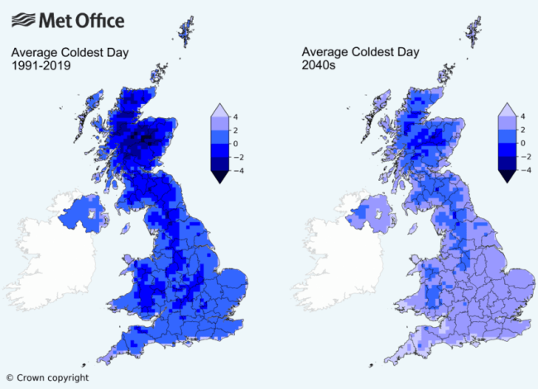
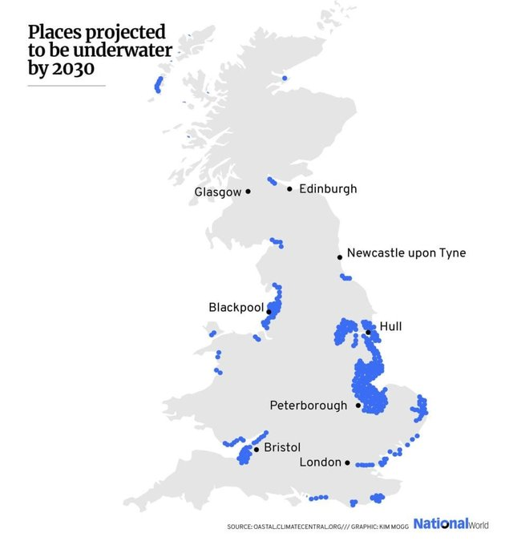
UK Impacts of Climate Change
- Urban planners would need to re-think where to build new housing developments as floodplains are flooded more often.
- By 2080, some scientists suggest there will be a 75cm sea level rise – we could see an increase in storm surges. 30% of the UK’s population live within 10 miles of the coast. Low level areas of eastern England could be at threat of sea level rise (due to the melting glaciers). Coastal regions contain manufacturing, oil and gas terminals. £120 billion worth of infrastructure is at risk because of coastal flooding.
- In 2003, Europe experienced a 10 day heatwave. Temperatures reached 40°c across many parts of Europe - caused 35,000 deaths. In Kent, temperatures reached 38.5°c and in the UK alone 2000 people died.
- In general, summers will become hotter and drier. People who suffer from breathing difficulties such as asthma are more likely to become ill as pollution increases.
- By 2080 temperatures are expected to rise by 4°c. This would lead to water shortages although household heating bills would decrease.
- The Thames Barrier prevents London from being flooded. But in 2080, it is unlikely to stop the predicted storm surges and Central London could experience significant flooding - up to 2 metres deep.
- Plants/insects that birds feed on could disappear - Birds can't nest - populations could become extinct. The comma butterfly has already moved north to areas with a lower temperature.

Slide 9
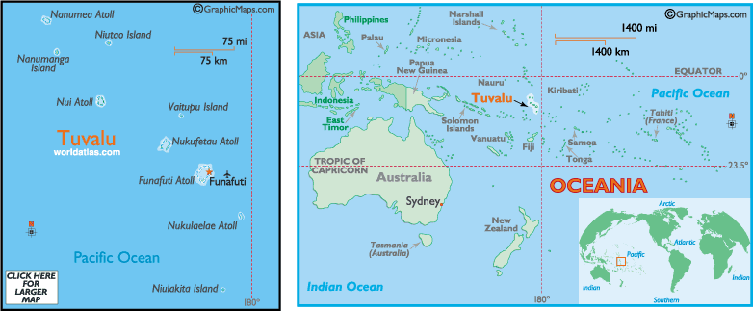
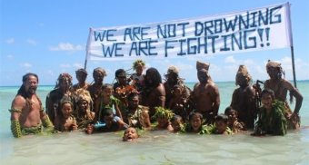
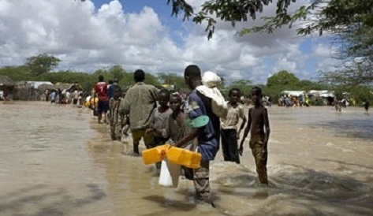
Rising Sea Levels: Tuvalu
Location
Tuvalu is a group of tiny islands in the South Pacific. Most islands are low-lying with the highest point being 4.5m above sea level. Population is 11,000 people and the economy relies mainly from exporting copra (dried coconut kernels).
Impacts from climate change
Economic
Increased levels of salinisation affects soil for agriculture
Coastal erosion destroys productive farmland
Main runway threatened by flooding
Reduced fish stocks especially tuna are affecting the main income (54% of income) generation
Social
Wells are becoming polluted by seawater
High tides are starting to threaten homes and roads
Reduction in water supply due to more frequent droughts
Environmental
Warmer temperatures are destroying fragile ecosystems such as coral reef
Ocean acidification and warmer temperatures are reducing fish stocks
Responses
4000 people (1/3 population) have already moved to New Zealand
Campaigning internationally for a reduction in carbon emissions.
Migration to safer islands off the coast of New Zealand.
Low sea walls have been constructed to prevent erosion and flooding.
Japan supporting coral reef restoration by introducing new species to damaged reefs.
New islands are being constructed higher above sea level
The vessel day scheme – to combat fish migration each country that is a member is allocated 45,000 fishing days which can be sold to other countries when there is no fish. You can buy days from other countries when you have a lot of fish. This means revenue can still be made when there is no fish in your waters.
Global response:
Kyoto Protocol came into force in 2005. 192 countries are part of the agreement to reduce carbon emissions to meet individual targets. USA is not signed up to the agreement and Canada withdrew in 2012. Developed countries are recognised as the responsible parties and are therefore expected to do more. There is a monitoring systems to hold countries to account.

Slide 10
Topic 3 – Distinctive Landscapes
Rivers:
Landforms created by geomorphic processes
River profile
Waterfall
Geomorphic processes operating at different scales and how these are influence by geology and climate
Human activities and management and their influences on the river
River Tees
Coasts:
Landforms created by geomorphic processes
Headlands and bays
Arches, stacks and stumps
Spits, estuaries, bars, tombolos
Geomorphic processes operating at different scales and how these are influence by geology and climate
Human activities and management and their influences on the coast
Jurassic Coast

Slide 11
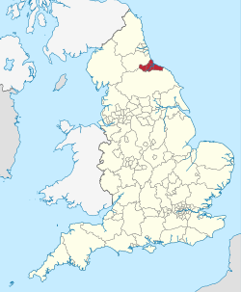
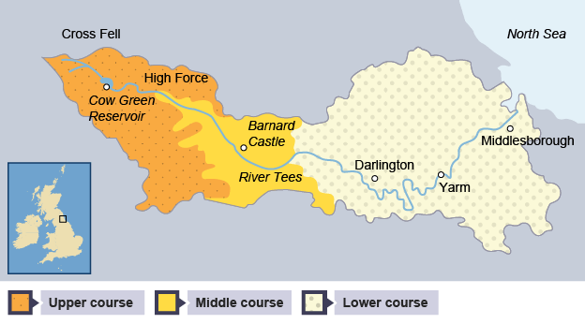
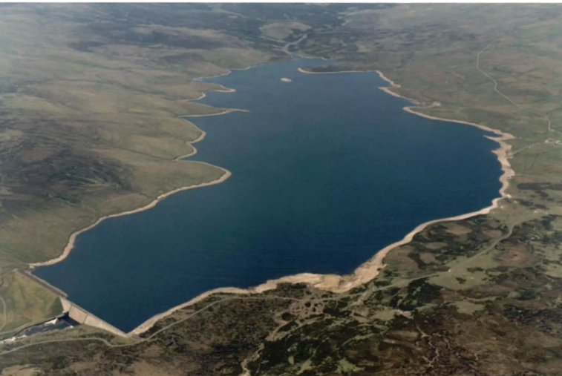
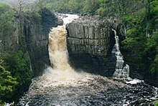
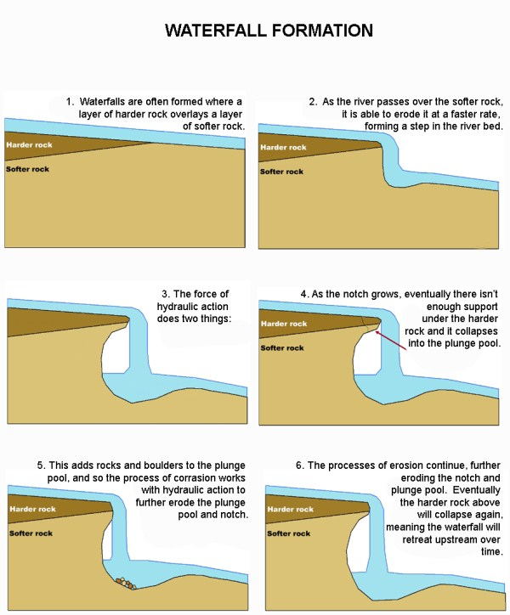
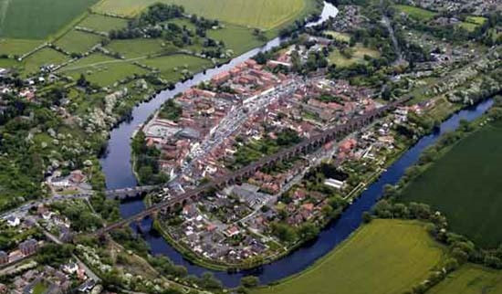
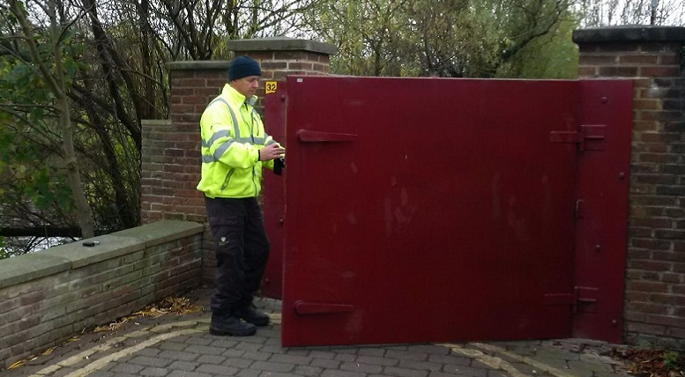
The River Tees
Location and Background
Located in the North of England it flows 137km from its source in the Pennine Hills where rainfall is 2000mm a year to its mouth in the North Sea near Middlesbrough.
The Upper course flows through open moorland and rough grazing where the main land use is agricultural. Run-off in the upper course is high due to the impermeable rocks and steep slopes. The river flows East and along the way there are many tributaries and confluences.
9 reservoirs have been built in the upper course to provide water for homes and industry and flood control to settlements. An example of these is the Cow Green reservoir which was built in 1967.
Cow Green reservoir holds 40,000 million litres of water. It is 2 miles long.
Geomorphic Processes
Upper – Features include V-Shaped valley, rapids and waterfalls. The rocks are impermeable and the vertical erosion creates steep valleys. High Force is a famous waterfall with a 21m drop and flows over a cap rock called Whinsill which sits on softer sandstone. This attracts visitors from all over the world. High Force is in a gorge which was formed by glacial ice melt in the last ice age. The waterfall during high flow becomes 2 and during extreme periods they join together the last time this happened was in 2015 during storm Desmond.
Middle – The gradient becomes less steep and lateral erosion is taking place. Features include meanders.
Lower – Greater lateral erosion creates features such as floodplains, large meanders and ox-bow lakes. The Tees floods often, during which fine sediment (alluvium) is deposited creating levees. The alluvium being deposited is very fertile creating good farmland. The mouth of the Tees is an estuary with mudflats and sandbanks.
Human activities
Yarm is a historic market town and was once an inland port. Yarm is built in a meander bend, the meander was used for defence but now it restricts the towns growth and means that it is prone to flooding. The most recent serious flood was in 1995 and since then a £2.1million flood defence scheme including gates have been built. There is a 1.3km flood wall protecting over 500 homes and businesses at a cost of £2.1million.New development on low-lying land is discouraged.
The estuary is used for heavy industry (Iron and steel works, engineering and plastics manufacturing) and it has important sites for wildlife. Some areas are SSSI’s and are carefully managed such as Seal Sands.
The river has been used for transportation since the industrial revolution and especially to support the steel industries along the river. Teesport is the 3rd largest port in the UK handling 56million tonnes of cargo a year.

Slide 12
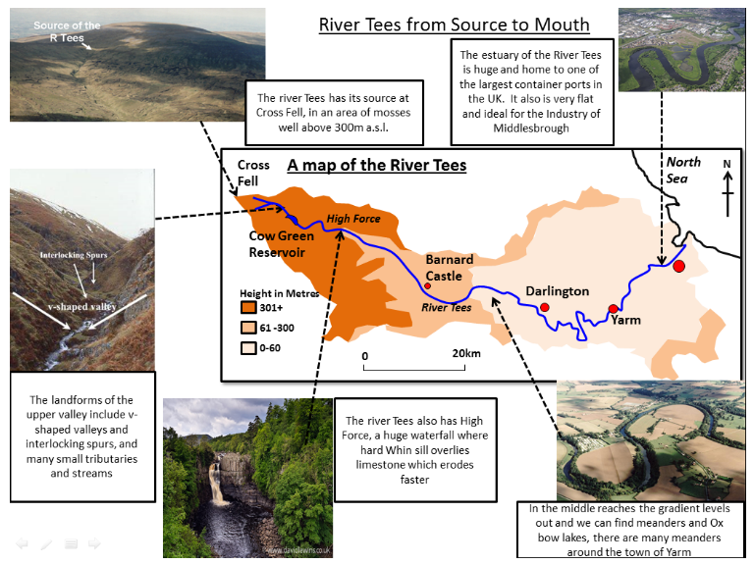
Human influence on the geomorphic processes at the river Tees
Tees barrage
- The biggest impact on the geomorphic processes is reduced sediment transportation downstream of the barrage, thus reducing deposition downstream.
- By regulating the flow of water, the barrage alters erosional and depositional patterns on a frequent basis. Controlled release encourages erosion in some places and deposition in others, changing the overall morphology of the channel.
- Changes to sediment deposition and transportation can impact habitats immediately on either side of the river altering mass movement and biological weathering.
- A reduction in flooding leads to a reduction of deposition on the flood plains.
Lower course land use
- The industrial use of the lower course of the river Tees means that pollution often gets into the river system which can change the characteristics of river ecosystems. Pollutants can reduce plant and animal life in and on the banks of the river reducing biological weathering. Less plant life on river banks may reduce the strength of the ground soils leading to more mass movement.
Urbanisation along the Tees
- Urbanisation along the Tees has will reduce infiltration of water and increase surface runoff. During storm events the quantity of water reaching the Tees will increase leading to faster flow and therefore increased erosion and sediment transportation than there would be naturally.
-Urbanisation also means increased waste and pollutants reach the river once again changing conditions for marine life and reducing biological weathering. Reduced bank vegetation will increase mass movement.
Management
All rivers have a management plan written by the Environment Agency & other agencies. Cutoff’s were built near Stockton-on-Tees in the 19th Century to straighten the river for boats. Flood plain zoning has ensured that the river can flood naturally and expensive barriers are not needed everywhere.
The Tees Barrage in Stockton-on-Tees was built in 1995 and cost £54 million to build. It is 70m wide and has opened up 25km of navigable water upstream for leisure. The barrage acted as a catalyst for £500 million of investment in housing, offices, schools and leisure activities in the area. The barrage stops tidal processes
from raising river height upstream reducing flood risk. Although it essentially blocks the stream it does not damage salmon migration upstream as there is a system in place that allows them to get around the barrier. The surrounding area has benefitted from the barrage, there has been widespread regeneration and job creation as well as 100,000 trees being planted to increase environmental sustainability in the area.

Slide 13
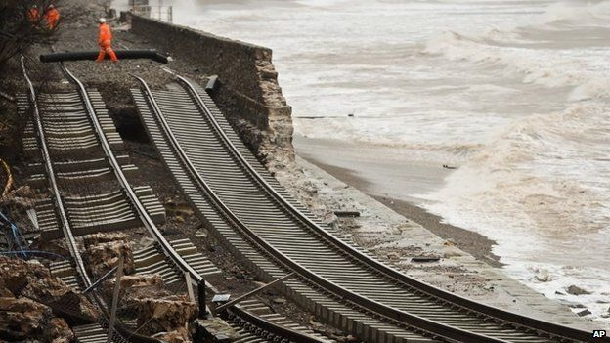
The Jurassic Coastline
Basic details:
Coast of Dorset and Devon in the South of England. 155km of cliffs and beaches and is a UNESCO world heritage site. It’s called the Jurassic Coast because of the age of the sedimentary rocks (they are 250 million years old).
How was the landscape formed?
The landscape has formed over the last 250 million years.
Triassic period (250 million years ago): the climate was desert like and formed thick layers of sedimentary rock.
Jurassic period (200 million years ago): sea levels rose and flooded the desert. Thick layers of sandstone were deposited.
Cretaceous period (140 million years ago): the sea level dropped and made new rocks, then the sea covered the land again and deposited more sandstone.
Quaternary period (2 million years ago): erosion created hills and cliffs, the ice age ended 10,000 years ago and sea levels to create our coastline.
Geology
The different rock types affect the landforms seen along the coastline
The impact of climate change on the Jurassic Coastline
Warmer temperatures will lead to bigger storms with more powerful, larger waves
Sea levels will rise due to global warming. This will make flooding more likely to happen.
More intense rainfall will lead to more weathering and erosion.
Concordant
Discordant
What were the impacts of the storm in 2014?
Sandstone cliffs collapsed in West Bay
The village Portland Bill was flooded
Lyme Regis was well protected by its defenses
Dawlish railway collapsed into the sea
How is the coastline managed and protected?
In order to protect Swanage Bay’s 1.8km of beaches they used a variety of engineering methods:​
Groynes – In 2005 they replaced groynes that had been built in the 1930s with 18 tropical hardwood timber groynes and materials salvaged from the old ones.​
Beach nourishment – In 2005 Swanage also deposited 90,000m³ of sediment, the cost of this replenishment was £2.2 million. The beach will need an additional 40,000m³ of sand every 20 years.​
Sea walls – Swanage bay’s 1.8km has along it a mixture of concrete and stone sea walls that reflect wave energy back towards the sea. Which at £30,000 per 10m calculates at £5.4m in cost.

Slide 14
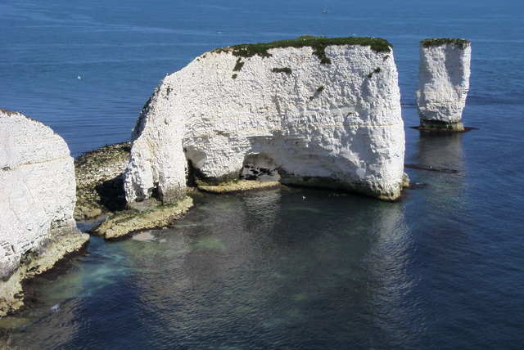
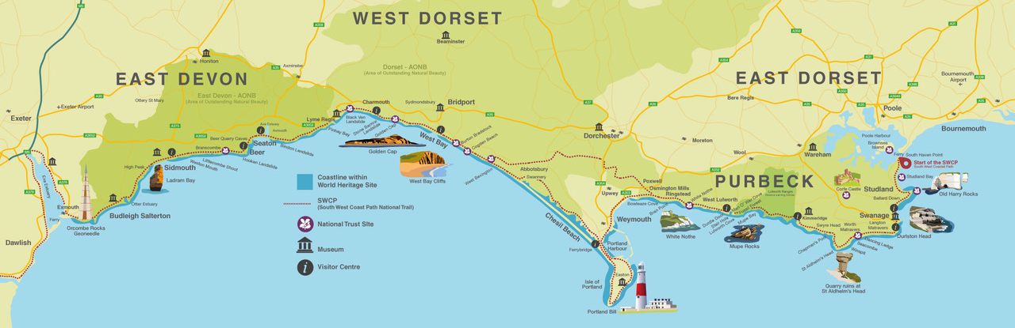
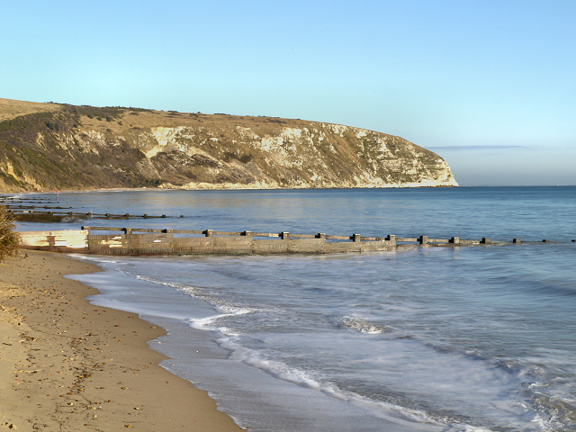
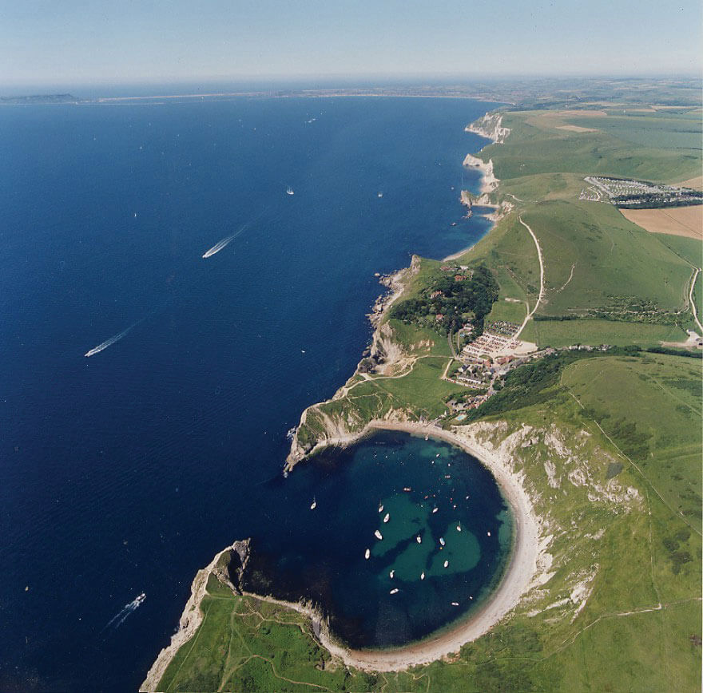
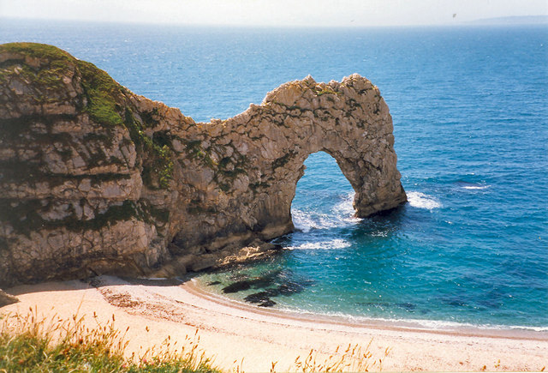
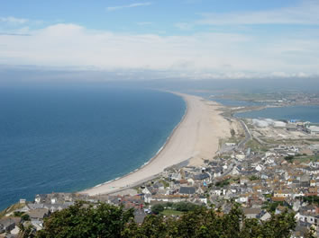
Old Harry Stack
This is a landform that has been created by erosional processes. It is made of chalk which is a harder rock. An arch at the end of the headland has collapsed to form a 21m tall stack called Old Harry and a stump called Old Harry's Wife. Chemical weathering and erosion (hydraulic action and abrasion) are gradually wearing these down. Biological weathering, caused by the vegetation on the top of the headland, is also breaking up the rock.
Durdle Door
This is one of the most spectacular natural arches in the British Isles. It is formed of limestone and is attached to the chalk of the mainland by a narrow “neck” of clay. The arch is gradually being worn away by mechanical, chemical and biological weathering.
Swanage Bay
The cliffs backing Swanage Bay are made of clay, which is a soft rock. Towards the northern end of the bay the cliffs are covered in vegetation, stabilising them and protecting them from erosion. Elsewhere, the cliffs are not covered by vegetation, so wet weather weakens them causing slumps. Longshore drift affects the bay carrying material from the south to the north of the beach. Erosion is the dominant process in the bay with the beach losing material year on year.
Lulworth Cove
At Lulworth Cove, the sea has formed a keyhole shaped bay in the softer clay behind the limestone. The limestone cliffs forming the back wall of the cove are vulnerable to mass movement and sometimes experience small slides and slumps.
Chesil Beach
A huge natural beach 15 miles long, stretching between Portland and West Bay. This is a spit and connects the Isle of Portland to the mainland. It has been created by longshore drift. Behind Chesil Beach is a lagoon called The Fleet Lagoon.

Slide 15
Topic 4 – Sustaining Ecosystems
Rainforests:
A case study to illustrate attempts to sustainably manage an area of tropical rainforest, such as ecotourism, community programmes, biosphere reserves and sustainable forestry, at a local or regional scale.
Polar ecosystems:
A case study to examine one small-scale example of sustainable management in either the Antarctic or the Arctic such as sustainable tourism, conservation and whaling.
A case study to examine one global example of sustainable management in either the Antarctic or the Arctic by investigating global actions such as Earth Summits or the Antarctic Treaty.

Slide 16
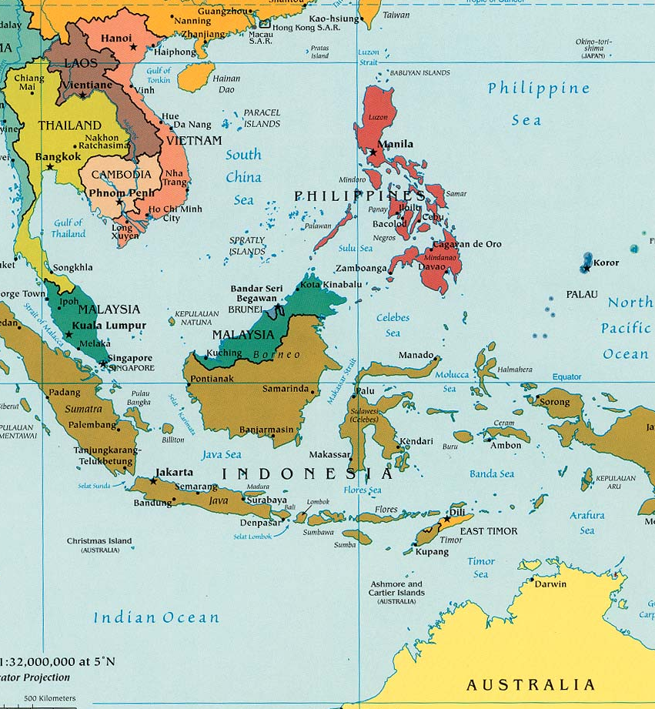
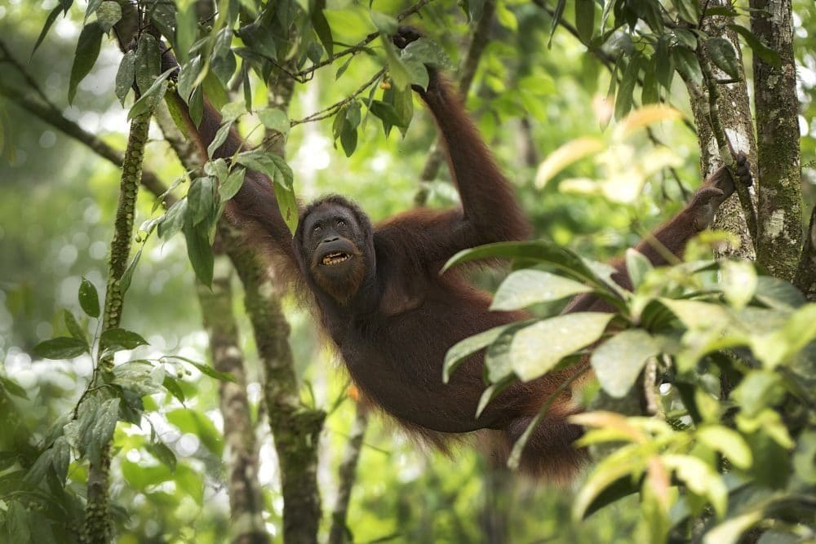
Sustainable Rainforest Management in the Crocker Range Biosphere Reserve, Borneo
Location
In 2014, the largest protected area of Sabah on the island of Borneo in Malaysia was designated as a UNESCO Biosphere Reserve. This is a local, small-scale example of ecosystem management. The reserve stretches 120km north and south and 40km east and west, covering an area just over 350,000 hectares. It has a variety of tropical plants.
Why it is valuable
It is home to endangered species such as the orang-utan and clouded leopard. The clouded leopard is endemic to the islands of Borneo and Sumatra and there are fewer than 10,000 left in the wild. This makes them very vulnerable to human activity and environmental changes.
How is it being managed
There is a core area (green) of legally protected forest reserves. The central area is covered by natural vegetation and is strictly for long-term research projects, education and tourism. The population in this zone is only around 200 and they are often involved in small-scale agriculture. There are six plots measuring 50 by 10 miles that are for ecological monitoring. They contain 300 plant species, 200 mammals and over 250 bird species. In the buffer zone (blue), there are 400 communities involved in small scale agriculture and rubber plantations which are carefully observed. The transition zone contains 264 villages who grow vegetables to supply the local towns. Hunting activities are still part of cultural traditions e.g. the hunting of pigs.
How else is the rainforest sustainably managed?
Agroforestry: this is where trees and crops grow side by side. The roots of the trees stop soil erosion and crops benefit from the nutrients they can get from the tree.
Selective logging: only older trees are cut down, young trees are allowed to grow to keep the canopy later tall.
Afforestation: trees are planted to replace any that are cut down.
Monitoring: the government use satellites to take regular photos of the rainforest, this way they can see if any areas are being cut down.

Slide 17
How are the locals involved:
Locals would use slash and burn cultivation that would leave a mosaic pattern of secondary forests (new growth re grown forests not as good as old growth ancient forests)
In villages land use planning was very rare and so to tackle this within the buffer zones they will create community conserved areas (CCAs) defined as Natural and modified ecosystems that contain significant biodiversity values, ecological services and cultural values, voluntarily conserved by indigenous and local communities
By incorporating local people into the land planning process they could draw on local expertise and knowledge of land use systems to create the best outcomes. By combining this with GIS (GIS can plug gaps in areas where data is not easily accessible) they created an approach to land management called PGIS (Participatory Geographical Information Systems). In short practical knowledge of local communities complements scientific knowledge of GIS analysts.
An example of a village in Crocker range buffer zone is Wassai. Their village covers hilly rugged terrain that ranges between 450m to 1480m and has a population estimated at 280. They cultivate their hills in the form of paddies to feed themselves and produce an income from fishing and exchanging non timber forest products for cash. Villagers in Wassai took part in a PGIS scheme, a workshop put on by researchers attracted 38 villagers who provided information about fauna and flora sightings, places for potential tourist trails, potential water pollutants, forest product collection locations, previous landslide locations and which of those landslide areas had been restored. GIS analysts took all the information given by locals and using satellite imagery and classification tools made a map of the area which was split into 3 zones 1. conservation zone 2. compatible use zone 3. no restriction zone. 37% of Wassai is in zone 1. Future proposed tourist trails and land use is then decided using this map of zones informed by both local information and science.

Slide 18
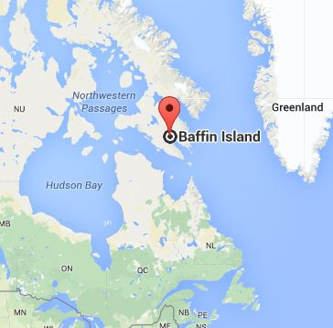
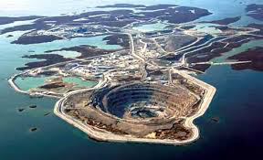
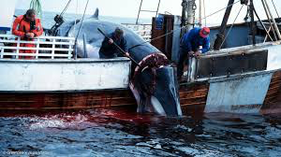
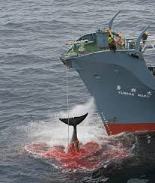
Sustainably managing Whaling, Arctic circle
Your small scale case study
Whales have been hunted for centuries. Inuits (Eskimos) hunt whales for oil, meat and bones. However, countries and companies started to hunt whales and this became unsustainable.
Whaling in the 20th century
In the 1930s over 50,000 whales were being killed every year. Huge factory ships were catching 10-20 whales each time to make products like margarine, chemicals and make up. In 1946 the International Whaling Commission (IWC) was set up to protect whales. It sets a total number of whales that each country can catch. In 1986 the IWC banned commercial whaling (whaling to make products), however Japan continued to catch whales for what they called ‘scientific research’. Since 1986 30,000 whales have been caught, mostly by Japan.
The Marine Wildlife Sanctuary
This safe place for sea animals was set up on the coast of Baffin Island in 2008, Northern Canada by the WWF and the Canadian government. $1million was invested in the area. The sanctuary covers 12 miles and protects 17 species of whale. Up to 2,000 bowhead whales stop in the area every year on their migration. Polar bears, seals and fish also benefit from the sanctuary. It is illegal for whaling ships to come into this area. 1,000 Inuit people live on Baffin Island and Greenpeace support them hunting Whales. Greenpeace want to work with the Inuits (indigenous people) and make a joint stand against oil drilling in the Arctic Ocean. Inuit people only live off what they need and they use every part of the Whale in their way of life.
The Clyde river economic development society is responsible for arranging tourist activities in the area which is a popular destination for ice climbing (the cliffs of McBeth and Sam ford Fjord being the most popular).

Slide 19
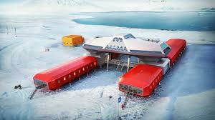
Managing the Arctic and Antarctica sustainably
The Arctic – not protected
Why is the Arctic a fragile environment?
Resources like oil and whales are exploited
Global warming causes climate change
The minimum area of ice shrinks each year
Why does it need protecting?
It reflects the sun’s energy (Albedo effect) keeping our global temperature cooler
It is a habitat and breeding place for hundreds of species
Very little of the land is currently protected – it means that any countries can go and exploit the resources in the area.
How is the Arctic protected?
It isn’t!
1996 – 8 countries came together to form the Arctic Council. It’s goal is to protect the fragile Arctic environment but it has no legal powers to prevent any countries carrying out harmful activities.
Greenpeace
Greenpeace is campaigning for the ‘Arctic Sanctuary’. This sanctuary would cover 3 million miles of the Arctic Ocean and ban any harmful human activity. At the moment, this part of the ocean isn’t owned by anyone. Within the sanctuary they would ban…
Fishing
Drilling for gas or oil
Mining
Military activtiy
The Paris climate agreement
This international agreement was signed by 195 countries in 2015. the agreement sets out a plan to help the world avoid dangerous climate change by limiting global warming to less than 2 degrees. This could help slow the rate of sea ice melting and sea levels rising in the Arctic area.
Antarctica–protected
The Antarctic treaty was signed in 1961 by 46 countries because the area was under threat
Humans are only allowed on the continent for scientific research and tourism
Tourism is limited to 100 visitors a year
No sewage must be discharged at sea
The scientific research there discovered the o-zone layer. This helped humans identify how our greenhouse gases were destroying it.
This scientific research has benefitted the future of our planet
No territorial claims have been recognised meaning no one country owns any section of Antarctica
Some say this agreement does not go far enough and that the agreement should include the sea around Antarctica
Your international/global scale case study

Slide 20
Topic 5 – Urban Futures
Life in an AC city (Leeds):
Cities location and importance within the region, country, globally
Patterns of national and international migration and how this is changing the growth and character of the city
Ways of life in the city (culture, ethnicity, housing, leisure and consumption)
Challenges that affect life in the city (housing availability, transport provision, access to services and inequality)
One initiative to make it more sustainable (e.g. HS2, Mailbox, waste management)
Life in an EDC city (Bangalore):
Cities location and importance within the region, country, globally
Patterns of national and international migration and how this is changing the growth and character of the city
Ways of life in the city (culture, ethnicity, housing, leisure and consumption)
Challenges that affect life in the city (squatter settlements, informal sector jobs, health or waste disposal)
One initiative to make it more sustainable (e.g. Programa Favela-Bairro, recycling / waste management, pacification, retrofitting)

Slide 21
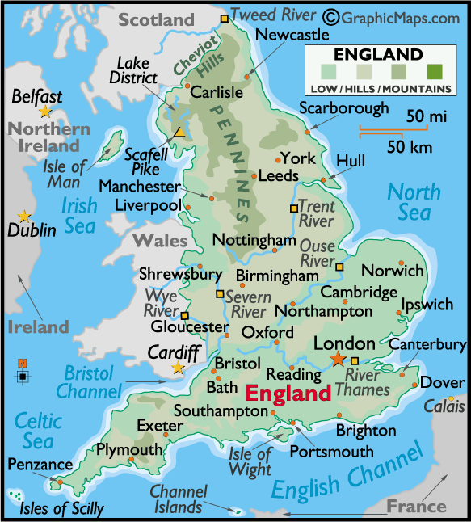
AC: Challenges & Opportunities for Cities: LEEDS
Location and Background
Leeds is the largest city in West Yorkshire and the 2rd largest financial hub in the United Kingdom. The city is at the heart of a conurbation which includes cities such as Bradford and Huddersfield. Leeds is the UK’s fastest growing city with a 6.8% growth rate between 2010 – 2020.
Cities Importance
Has the fastest rate of job growth in the country.
Third largest manufacturing centre in the UK, especially for clothing.
Contains four independent universities.
After London the most important financial centre in UK.
Has major transport links that connect effectively to the UK and the world including an airport.
Major transport links to London via the M1 and 2 hours by rail.
Migration to Leeds
Leeds began in Saxon times but developed into a major manufacturing location during the industrial revolution and Victorian era of the 1800s. Now Leeds is a truly multicultural city with 18% being from black and minorities communities.
Many commonwealth populations, such as India, moved in during the 1950s.
The city is also home to a large Irish community from the mid 21st century who historically used the Leeds Liverpool canal .
Polish, Ukrainian & Hungarian refugees arrived after WWII avoiding Soviet austerity.
Industry
The early wealth of the city came from wool being woven and dyed in the city. Other industry like pottery and brick making started later. The Leeds-Liverpool canal provided a transport route to the coast.
Leeds way of life
The city benefits by the diversity and many different cultures.
The population benefits from many companies and shops locating there including ASDA’s HQ.
City is only a short distance from Yorkshire Dales National Park.
Good entrainment centres and night life.
A centre for arts with a number of galleries and music venues.
Expensive area of the city is Roundhay
There are many students living in the city who require a different range of services to the families (more entertainment)

Slide 22
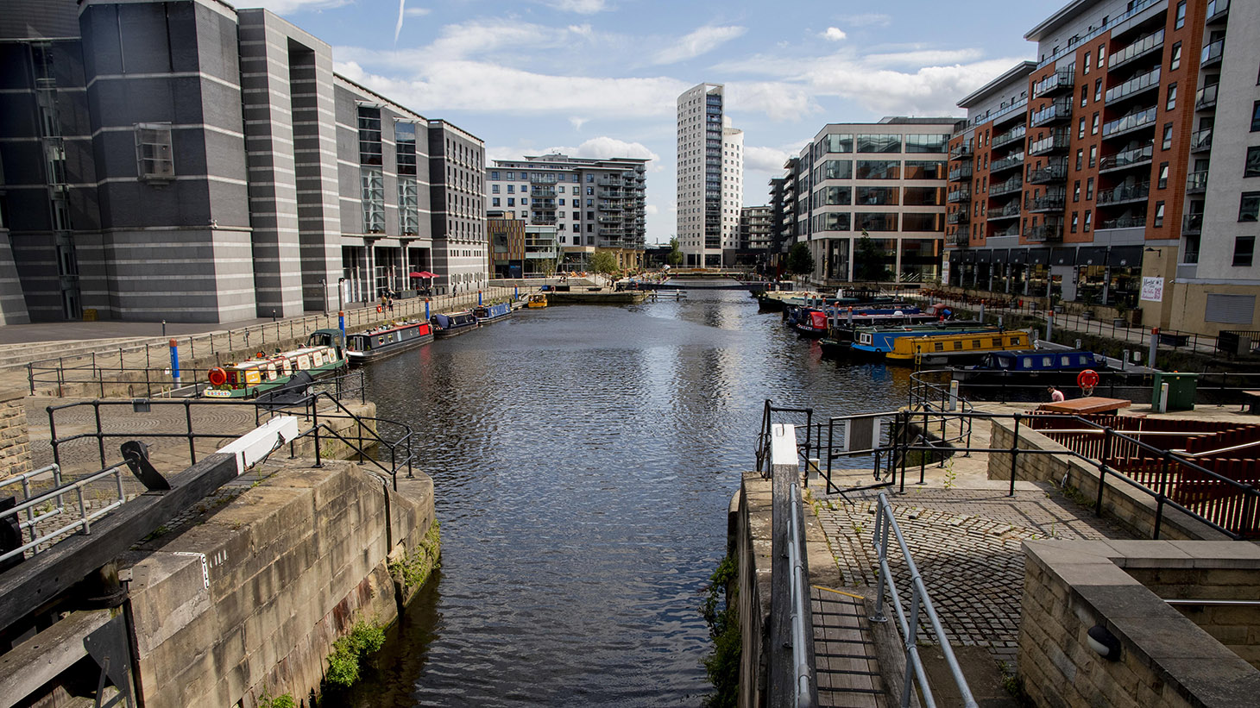
AC: Challenges & Opportunities for Cities: LEEDS
Leeds City Challenges
Studentification
A large number of students live in Leeds. Students move home during holidays and as a result are a transient population in Leeds. When large majorities of the population leave local business in Leeds suffer and the city appears empty.
Students also rent large houses of multiple occupants (HMO’s) on roads that also house local families. Having large amounts of student accommodation a road can become congested with traffic and parking can become a significant issue. Furthermore the students live a disruptive lifestyle which generates large amounts of waste and noise pollution.
An area of the city with lots of students in Headingly.
Other challenges
There is a lack of affordable housing, especially for the young generation.
Social inequality including deprivation and poverty is a problem for young people – 20% of children live in poverty
Some communities (Hyde Park) are being replaced by students (studentification) which then require different services (shops and entertainment).
The rapid increase in population has caused pressures on transport and services such as education.
Unemployment particularly among young people
Transport links within the city are poor with large sections not served by public transport
Cycling and walking networks are inconsistent and of poor quality
Waste disposal is inefficient and there is limited recycling within the city
South Bank Redevelopment
The south bank area (city centre) of Leeds is undergoing major development in the next decade. This will lead to…
Retail and leisure services being supported outside of working hours.
New flood technology will be built into reduce the risk of flooding from the river Aire
Water taxis and bus services to cut down carbon emissions
Cycle and pedestrian routes to be increased
New pedestrian and cycle bridges will connect open spaces
Developments will include the former mills
30 listed buildings will be included
35,000 jobs will be created
4,000 homes will be built
A new areas for contemporary arts.
Educational improvements to Leeds College.

Slide 23
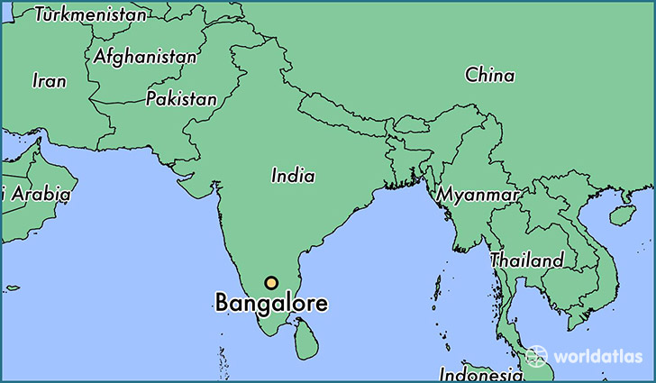
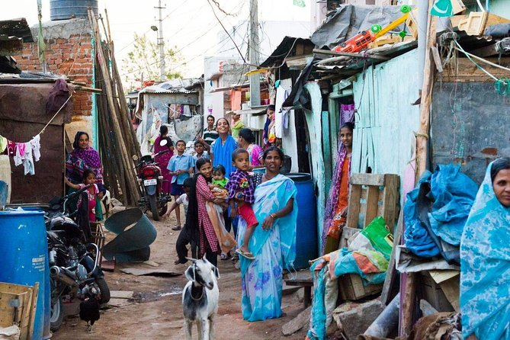
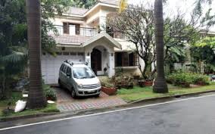
EDC: Challenges & Opportunities for Cities: BANGALORE, INDIA
Location and Background
Bangalore is located in the state of Karnataka which is in the south if India. It was under British rule from the beginning of the nineteenth century, which encouraged development of roads and railways and helped Bangalore to become a centre for agriculture and later a manufacturing and service centre.
Cities Importance
Bangalore is a major IT hub. It attracts employees from all over the country to work in the jobs. Recently the city has become a major centre for IT and biotechnology industries. Transnational companies (TNCs) including Google and Microsoft have found there are huge cost advantages in setting up bases in Bangalore, which has an English speaking, highly educated workforce available at less than a quarter of the wages paid in the USA or Europe. Special Economic Zones (SEZ’s) where less tax is paid has encouraged TNCs to the city.
Bangalore’s way of life
19% of residents of Bangalore are wealthy and enjoy the garden city life style with high quality education and western style shopping malls. They live in gated communities where they have lush gardens and other water intense lifestyles (western flush toilets). They own cars and send their children to private schools. These residents work in the IT industries in the city. Whitefield in the East of Bangalore is one of these areas.
About 10% of the population live in slums. Here they have small homes with a lack of basic facilities such as water and sanitation. Children attend schools which are taught in Kannada (the local language) but many of them don’t speak Kannada. These residents work in manual jobs.
The rest of the population live in small apartments. Lots of new buildings are being built all over the city.
Migration
Over the years the city has attracted millions of migrants from other parts of India and abroad. Fewer than 25% of Bangalore's inhabitants speak the local language (Kannada) because they are migrants.
For many years Bangalore has been a centre for government-owned companies, which employ large numbers of people. Hindustan Aeronautics, for example, has over 9,500 employees. Government owned companies provide job security, good pay and pensions, and excellent facilities such as housing and schools. They attract well-qualified people to move to Bangalore from all over India bringing with them a variety of cultures and languages. Less educated migrants work as security guards and gardeners for the wealthy.
Almost 50% of Bangalore's residents are migrants

Slide 24
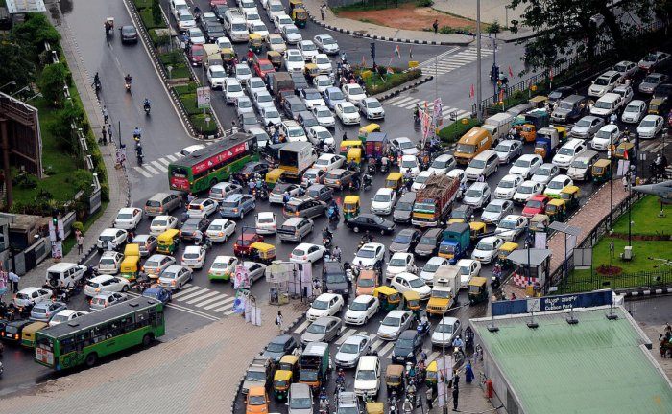
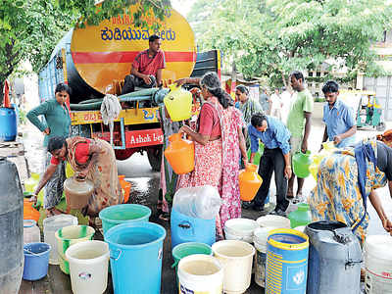
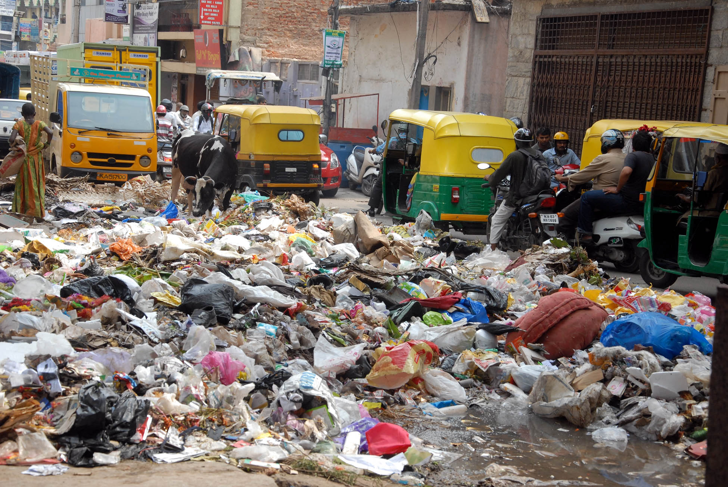
Challenges and Sustainable Solutions
Traffic congestion
About 1000 people move into Bangalore every day and the growth of the city is unplanned and the infrastructure has failed to keep up. More and more people living in the city own cars. The roads in the city were not built for the number on them so there are frequent traffic jams. Traffic moves an average of 4 – 5 km per hour which is slower than walking pace. People are stuck in traffic for an average of 10days 3 hours a year. The delays cost the city 65bn rupees a year in lost productivity. To solve the problems roads are being widened by knocking down buildings and new fly overs are being built. The metro system is being enlarged and bus routes are being increased. The metro has not had much uptake and there a limited number of metro stations. The building of the metro is very slow with only 28km of the planned 42km line opened in 10 years.
Waste disposal
More and more plastic is being used in packaging and the rubbish collection system is not good enough. Currently only 60% of household waste is collected. The city generates 5,000 tonnes of rubbish a day. One solution is to provide residents with a composter so they can dispose of their own vegetable waste. They have also introduced autorickshaws to collect rubbish in narrow streets. It was trialled collecting wet and dry waste separately to increase the amount collected but this had no impact and so was scrapped in 2019.
Water
As more people move into the city, more water is needed and there isn’t enough to go around. Water used to come from lakes and reservoirs in the city but there are only 20% of these left. Water now comes from the River Kaveri 150km away in Mysore through pipes which were constructed in 1896 and now leak. The city needs 1125million litres a day and can only supply 900 million. One solution is to make all new houses have a rainwater-harvesting system. This collects rainwater during the monsoon and stores it to use later in the year. By 2019 only 120,000 buildings had the rainwater harvesting implemented.
ARE THESE SUSTAINABLE?

Slide 25
Topic 6 – Dynamic Development
LIDC case study: Zambia
Overview of their economic development
Link to Rostow’s model
Have the MDGs been achieved for this LIDC?
How wider context has influenced their development
Political, social and environmental
Trade
Impacts (benefits and problems) of TNC investment
Advantages and disadvantages of aid or debt relief for development
Advantages and disadvantages of one top-down and one bottom-up approach strategy

Slide 26
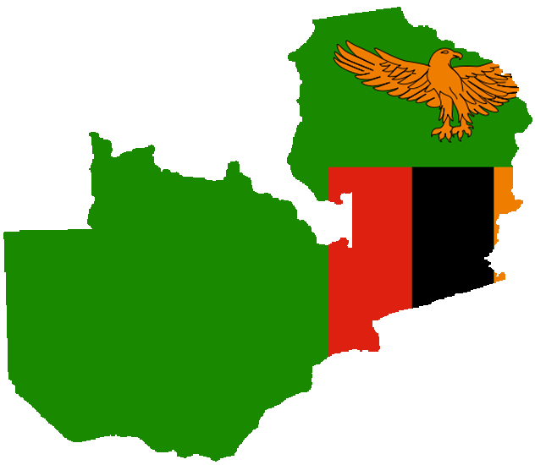
Zambia
A brief history…
Is rich in minerals like copper but has never developed. It is landlocked and was a Britsh colony in 1888 until 1964. With a population of 14 million, 80% can read and write and the gross national income is $3,000.
Development over time…
1964 – Zambia gains independence
1970 – the price of copper falls and Zambia has to accept aid.
1975 - Kariba dam produces electricity
1980 - AIDS spreads across Zambia and life expectancy falls
1990 – debt is high. Food is expensive and there are riots.
2000 – copper starts to rise again.
2006 – the IMF cancel Zambia’s debt.
2010 – Zambia develops new industries in tourism, farming and hydro electric power through the Kariba Dam.
When Zambia became independent it was expected to follow the same path as advanced countries towards development. The Rostow Model shows a smooth path to development. The model is based on the experience of ACs. However Zambia’s path to development has been more of a zigzag than a straight line, with a series of ups and downs
The Millennium Development Goals (MDGs)
In 2000 world leaders agreed to 8 MDGs. They are…
Halve extreme poverty and and hunger
Reduce child mortality
Improve maternal health
Achieve universal primary education
It did meet the goals​ of:
​Achieve universal primary education - UN reports show that primary school enrolment in Zambia was 80 % in 1980. It increased to more than 90 % in 2010 and reached 100 % in 2015. Now only 42% of secondary age children attend school with a large gender imbalance.
Combatting HIV – Zambia managed to reduce its prevalence percentage to 14.3% well below their target of 15.6% 2 years before the deadline furthermore the amount of people with advanced AIDS that have access to ARV medication has increased to 79% which means they were well on track to combating HIV. ​
​
It did not meet the goals​ of:
​Improve maternal health - In 2000 there were 2,500 maternal deaths. By the year 2015 this had dropped to 1,400. In the UK the number was 60 in 2015. Mothers still die due to HIV/AIDs and Malnutrition.
Poverty – The percentage of people living in poverty in Zambia is 42.3% which is 13% higher than their goal. To reach their goal they must remove 2.34 million people from poverty in 2 years.
Zambia’s reliance on a single commodity – Copper
Zambia relies on the copper metal it has, it makes up 70% of its international export. Between 1970-2000 the price of copper fell and this put the economy into decline and Zambia went into debt. Since 2000 the price has risen but Zambia wants to diversify its economy. China uses the most copper in the world and has therefore invested in Zambia. Over 500 Chinese companies invest in Zambia from mining to tourism to manufacturing. China has expanded the Kariba Dam, built 8,000km of new roads and there are 100,000 Chinese people now living and working in Zambia.

Slide 27
Zambia
Foreign investment
In 2012 Zambia started a project called ‘Why invest in Zambia?’. The country has been a peaceful democracy since 1964, the economy has been growing since 2000, Zambia borders 8 countries and is part of the World Trade Organisation (WTO) and 50% of its land is suitable for farming.
Benefits of TNCs…
Provide jobs and an income
The company an workers pay taxes which supports the government
Investment helps the country exploit its natural resources
Problems of TNCs…
Large companies try to avoid paying tax
Small companies can’t compete
They pollute and damage the environment
TNCs in Zambia:
Associated British Foods (ABF) own Silver Spoon, Kingsmill and Twinings Tea. ABF bought Zambia Sugar in 2001. Zambia sugar paid almost no tax in Zambia because profits were sent to ABF in the UK where tax rates are lower. Zambia, like other LIDCs needs taxes to pay for services like education and healthcare, but it also wants to offer tax incentives to encourage TNCs into the country.
ABF exports 50% of its sugar to Europe while the other 50% is consumed within Zambia itself.
“We estimate that Zambia has lost tax revenues of some $17.7m since 2007, when ABF took over the Illovo sugar group,” the ActionAid report said.
In 2010 the company, employed 1,848 permanent workers and 3,530 seasonal labourers.
According to ABF the company also initiated social projects costing £3.94m including housing 16,000 people, proving them with water and constructing a maternity ward in Mazabuka District Hospital
Debt relief in Zambia:
By the year 2004 Zambia owed roughly $7billion in debts to Western banks.
In 1991 75% of the population lived on less than $2 a day. By 2003 this had risen to 85%.
In 2005 Zambia had $ 4 billion of debt cancelled.
Because of this debt relief the government has been able to use their money for education, health and welfare instead of paying off its debt. For example:
Primary education was made free for all
100,000 people were provided with free anti-retroviral drugs (for HIV)
The Zambian government still owes at least £180million in debt repayment
Water Aid in Zambia
Water Aid is needed because 5.2m people don’t have access to clean water, 5,000 children die every year from water borne diseases. In one year Water Aid provides 54,000 people with safe water and 42,000 people with improved sanitation.
Top down development – ‘The Kariba Dam’ The Kariba Dam is on the Zambezi river on the border between Zambia and Zimbabwe. The dam, completed in 1959, is 128m high and creates Lake Kariba. | Bottom up development – ‘Room to Read’ Room to Read is an American NGO working to improve literacy and gender equality in Zambia. It launched in Zambia in 2007 and 582 Literacy Programme Schools established
Advantages: power is vital for the copper industry, renewable form of energy, fishing and tourism have developed around the Lake. 6.7 billion kilowatt-hours of green electricity every year. The price of energy reduced by 30%. | It aims to increase the years of schooling for girls, increase girls self awareness and life skills, increase family and community support for girls education.
Disadvantages: 57,000 local people were evicted from the land and moved to less fertile land. 30,000 Tonga people had to move. 6000 animals had to be relocated. Natural flooding no longer occurs leading to loss of farmland and ecosystems. The dam blocked fish migration upstream. | Room to Read have worked with 529,000 children in total with 2,072 girls in the programme. They have built libraries and 43 of them have been given to the local district to run. Room to Read have worked with Head Teachers and Librarians to train them to ensure sustainability of the programme. Room to read only operate in 3 of the 9 regions of the country
The future…the dam could collapse because of erosion. Mozambique would be flooded within hours, ecosystemsa and wildlife wold be lost and 3.5 million peoples lives would be at risk from flooding. | Reading for success…school attendance is poor and there are very few schools in Zambia’s countryside. Room to Read trais teachers to engage students, children like Milmo travel 90mins to school and he is learning to read, he wants to become a teacher one day himself.

Slide 28
Topic 7 – UK in the 21st Century
• Identify the changes in one economic hub and its significance to its region and the UK.
Examine the UK’s political role in one global conflict through its participation in international organisations.
A summary of the how the population structure and ethnic diversity of a named place of the UK has changed since 2001

Slide 29
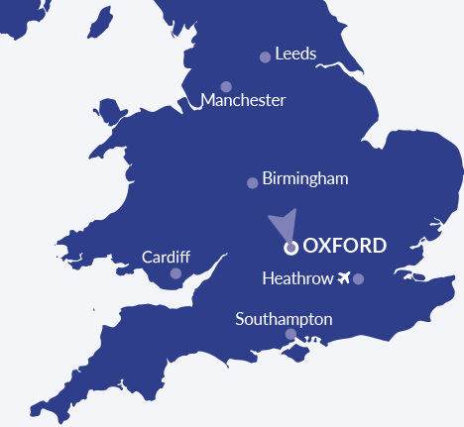
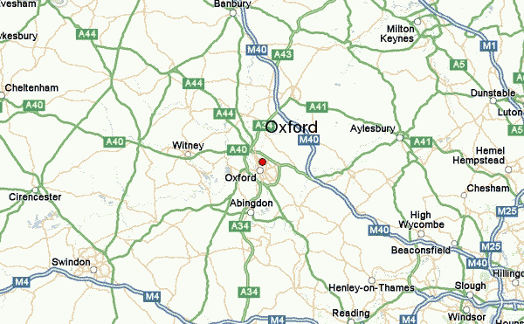
UK Economic Hub - Oxford
Oxfordshire is one of the UK’s most important locations for scientific and technological industries. Centred on Oxford with its world-class universities, a cluster of high-technology industries has developed including high-performance engineering, space and medical research.
The University of Oxford and Oxford Brooks University produce many graduates every year
Oxford has a rich history and beautiful countryside
Oxford is well served by rail and road
BMW have a manufacturing plant and Formula 1 have a research facility in Oxford
Several big research companies (eg The Medical Research Council) attract others to the area
There are over 4300 high tech jobs in Oxford
Around 1500 technology companies based in the city
Changes over time
The number of companies has increased and the science parks have grown
New road networks, buildings and infrastructure have been built
New homes have been built to house all the employees – 1400 have been built on the Harwell Campus
The research companies have not been in business for very long and lots of companies shut down or change ownership often. This shows how fragile the science and technology industry are.
Regional significance
Lots of people want to move to Oxford for the many jobs. This has put a huge strain on the services in the area. House prices have increased significantly leaving people on low incomes with no home.
Commuting time is high due to congested roads meaning high levels of air pollution
Large amounts of money have been spent in shops, restaurants and hotels. Money has been brought in from all over the world as people visit for business and pleasure
Support industries in the area and the rest of the UK have benefitted from the growth in Oxford. Construction, maintenance, servicing, education and retail have all benefitted
The success of Oxford has increased the UK’s North South divide
Significance to the UK
Oxford Instruments is one of the regions successful companies. It has brought significant wealth to the country. They employ 1500 people globally.
Oxfordshire high-tech companies bring a lot of status to the country. The UK is associated with some of the highly respected and innovative companies in medicine and motorsport.
It is home to the second best university in the world with well established research institution which gives oxford global recognition significance
Oxford Astra Zenca Vaccine was developed giving status and recognition to UK medical research
Oxford University contributes £15.7 billion to the UK economy

Slide 30
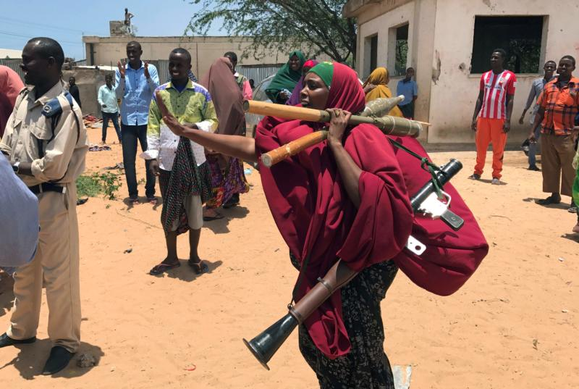
The UK’s Role in Resolving Conflict in Somalia
Background
The northern part of Somalia is called Somaliland. It borders the Gulf of Aden. Much of this area is mountainous.
The rest of Somalia borders the Indian Ocean. The land here is much flatter and most of it is dry semi-desert. This is an extremely hostile environment to live in.
Somalia has a population of 15.4million (67 million in the UK)
Somalia was formed in 1960. Before then, the area was controlled by the UK and Italy. Disputes with its neighbours – Kenya, Djibouti and Ethiopia – soon broke out over the land that was settled by Somali people.
In 1991 President Siad Barre was overthrown and the country was thrown into chaos. For two decades there was no government. Fighting between rival warlords ravaged the country. It was ill-equipped to deal with the droughts and famines of 1992 and 2010-12 that killed an estimated 500,000 people.
In 2012 an internationally backed government was installed and a degree of stability was returned. The decades of conflict have left Somalia as one of the poorest countries in the world.
UK involvement
The UK is part of the UN. Troops were sent to monitor a cease fire in 1992 but finally withdrew in 1995 leaving the warlords to fight on.
The UK’s Department for International Development is working with the new Somali government to address the shortages in food, employment and healthcare. Its healthcare programmes, such as Joint Health and Nutrition Programme for Somalia, aim to save thousands of lives and provide an essential package of health care services. The UK government is also investing in programmes addressing the problems of piracy, terrorism and migration. The cost of these programmes is estimated to be £500million (2012 – 2017)
In 2016 the UK government announced that it would send a British military team to train troops and help combat human rights abuses. An additional £50million was promised to the region.
Several UK charities such as Oxfam and Save the Children work in Somalia to reduce the poverty and address issues of health and human rights.
Spent £40m to facilitate local peace agreements, provide alternative jobs for militia, build infrastructure and help create new local government administrations..
£38m increase in revenue collection to build core state functions at central and local levels (local government and tax)
Success?
In 2021 there were still 3 million internally displaced people
Elections were scheduled in 2019 but they were postponed due to Covid. They were finally completed in May 2022 with a peaceful transfer of power.
The United Nations Assistance Mission in Somalia (UNSOM) recorded at least 899 civilian casualties, including 441 killings, between late November 2020 and late July; a marked increase compared to the same reporting period the previous year. Most were killed during targeted and indiscriminate Al-Shabab attacks using improvised explosive devices (IEDs), suicide bombings, and shelling, as well as assassinations.

Slide 31
Population structure, change and diversity in London since 2001
According to ‘https://data.london.gov.uk/dataset/londons-population’ London’s population is growing. In the year 2000 London’s population was approximately 7.4million and in 2020 that number had risen to 9 million. The UK’s population age structure is the main cause for this increase.
London population structure – The population pyramid (right) tells us about London’s population in 2011. The most prominent ages in London are 25-34 as many young professionals locate to London for work and young migrant families immigrate internationally. The large disparity between 0-4 and 5-9 also suggests that London’s birth rate has increased in the last 5 years or alternatively families with school age children are relocating to areas outside of London.
Diversity in London – In the 2011 census 38% of the London’s population were born abroad and between 2001 and 2011 the London’s population went from majority White British to a majority of other ethnic groups. Although much of that majority was born in the UK to immigrant parents/grandparents. London in 2011 was the second most ethnically diverse city in the world after New York. The table (below) shows London has experienced the most immigration from India with a population in London of 267,000 (2011)

Slide 32
Topic 8 – Resource Resilience
Case study of attempts to achieve food security in one country (Tanzania) to include:
• Investigation of statistics relating to food consumption and availability over time.
• The success of one attempt in helping achieve food security at a local scale such as food banks, urban gardens and allotments.
• The effectiveness of one past and one present attempt to achieve food security at a national scale such as global food trade, GM crops, ‘The Green Revolution’ and food production methods.

Slide 33
Tanzania – an attempt towards food security
Food security over time
Tanzania is ranked 105th out of 113 countries in the global food security index (2022)
Africa’s undernourishment is at just 20%, in 1991 it was at 28%. Tanzania’s undernourishment is at 33%, up from 24% in 1991.
However, since 2004 it has been recorded that there is enough food for everyone in Tanzania, this shows that the food isn’t equally distributed. The average number of calories per person in Tanzania has been rising.
Achieving food security at a local scale – Goat Aid in Babati | Achieving food security at a national scale (Past attempt 1968 - 1993)
The bottom up aid project run by Farm Africa imported £200,000 worth of Toggenburg goats, $400 each goat – they produce 3litres of milk a day. Villagers were trained in how to keep and care for the goats. The villagers had to pay back the money as the charity felt that if they were given for free, they wouldn't value and care for them. On average, villagers have spent 25% of their income on school fees and 20% on medical bills. In Tanzanian shillings Goat Aid farmers have earnt 2,203,854 whereas farmers not in the Goat Aid scheme get paid 763,880. These goats can survive on weeds and thorny bushes and they provide meat, milk and manure which can all be sold. Disadvantages Too small scale – doesn't impact nationally. Goats need lots of water – a scarce resource. Poverty has kept on increasing all over Africa. Vets bills are expensive Constant grazing and the goats hooves have increased soil erosion The number of hoofed animals in Africa has increased from 275 million in 1961 to 655 million in 2005. During that time poverty has increased not decreased. | In 1967 Tanzania started to grow its own food. Canada helped set up a wheat programme. Canada provided $95 million worth of aid along with seeds and machinery, eventually Tanzania had to pay them back. They chose to harvest on the Hanang Plains and had to force off the local people, the Barabaigs. People say that Barabaig villages were burnt down, the people were raped, beaten and killed if they opposed. It was partly successful… Provided 60% of it’s wheat Employed around 700 people Tanzania didn't rely on food aid during the 1992 drought 121 Tanzanians received training in wheat production 150 mechanics gained skills in maintaining farm machinery Rail, road and electricity connections were improved However… 40,000 Barabaigs were affected Food security of the Barabaigs gor worse Spare parts and fuel could not be afforded for the machinary and so many were left to rust Only one crop was grown so decreased biodiversity and soil fertility Most Tanzanians eat maize and connot afford bread made from what Would have been chepaer to import wheat Relatively only a few jobs were created

Slide 34
Tanzania – an attempt towards food security
Southern Agricultural Growth Corridor of Tanzania (Present attempt – started in 2010)
Tanzania has set up the Growth Corridor – a strip of land that is very fertile and connects to a port, and the TAZARA railway. It is hoped that by 2030 millions will be lifted out of poverty, and local transport networks will be developed creating a modern economy around crops and animal farming. It is hoped that money can be earnt from selling food to other countries.
$1.14 billion of investment is being spent on the Hub and outgrow model. They have 6 cluster areas with 188 commercial farms linked to smaller farms. The commercial farms have warehouses that will help local farmers and improve the quality of their seeds and food production. Local farmers will learn from the large farm. This has been successful so far with the Kilombero plantation doubling the amount of rice made in the area and benefitting 7300 local rice growers. This investment is coming from China, the EU and other sources.
Positives | Negatives
270000 small farms have been reached Double the amount of rice is now being grown Local farms now have electricity and irrigation (water) from the commercial farm Tobacco-processing factories have been built adding value to the raw product Farmers are able to get a higher price for goods as they have improved access to markets Olivado Tanzania, a SAGCOT partner has built a $2.5 million modern avocado oil production facility from scratch in Njombe region producing avocado oil from non-export grade avocados. This adds biodiversity and increase income to the area | Locals have lost land to the commercial farms Nomadic farmers have been disrupted and lost access to water for their animals Small landowners have not been involved in the decision making A lot of the promised investment has yet to be seen

